Slide 1
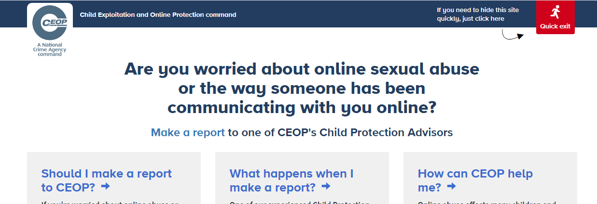
Whilst we are in lockdown it is important to be aware of how to keep yourself safe online. Please do use the school website still for resources on this. There is a link to the CEOP button which directs you to advisers who support young people if they want to report an issue regarding feeling uncomfortable when communicating with them online.

Slide 2
Parents' Ultimate Guide to Discord
https://www.commonsensemedia.org/blog/parents-ultimate-guide-to-discord
Over recent weeks we have received several alerts through the school system which seem to have arisen from students using their school email address to log in to the social media app ‘Discord’. This app now has 100 million users and has become really popular in the last year. Please do use this link to update yourself if you are not familiar with this platform.
The app was used for gaming initially but significantly has become an easy-to-use group-chatting tool for friends which is clearly appealing at this time. The safest way to use Discord is to only accept friend requests and participate in private servers with people you already know.
We ask that students do NOT use their school email to log in to this app.

