Slide 1
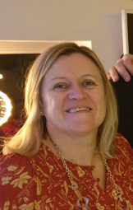
Duke of Edinburgh’s Award SILVER AWARD 2020-2021 Carried out in Year 10
£32 for Bronze and Silver
Leader: Dr V Walters (Science) Programme Assistant: Mrs C Kinchington

Slide 2
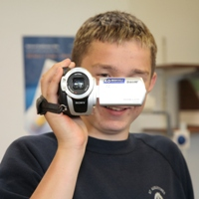
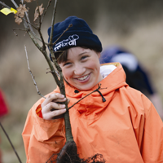
The ethos of the Duke of Edinburgh award
It is a recognition of a young person’s successful journey of self-discovery and development, renowned by employers and universities.
Its balanced programme develops the whole person in an environment of social interaction and team working. There are three progressive levels which, when successfully completed, lead to a Bronze, Silver or Gold award.

Slide 3
You can be assured that the DofE has made this year’s award as COVID SECURE as is possible in line with government regulations. There will not be a Parent Information Evening so please watch this presentation carefully as it will contain all the information needed for students and parents/carers.

Slide 4
Please watch this videoclip on the Silver award https://www.dofe.org/wp-content/uploads/videos/7.-DofE-Silver-Welcoming-young-people-Choose-your-activities-subtitled.mp4
BRONZE

Slide 5
Why do a Duke of Edinburgh’s Award?
Participation develops:
self-confidence,
resilience,
a sense of responsibility,
new talents and abilities,
the ability to plan and use time effectively,
self management
problem solving,
presentation skills,
communication skills,
the ability to lead and work as part of a team
Major employers consider the Duke of Edinburgh’s Award as the most important activity undertaken at school
Universities consider that undertaking the Award shows that young people have a suitably balanced character and transferable skills

Slide 6
You can do programmes at three levels:
Silver (Year 10)

Slide 7
There are four required sections:
Volunteering: undertaking service to individuals or the community
Physical: improving in an area of sport, dance or fitness activities
Skills: developing practical and social skills and personal interests
Expedition: planning, training for and completion of an adventurous journey in the UK or abroad

Slide 8
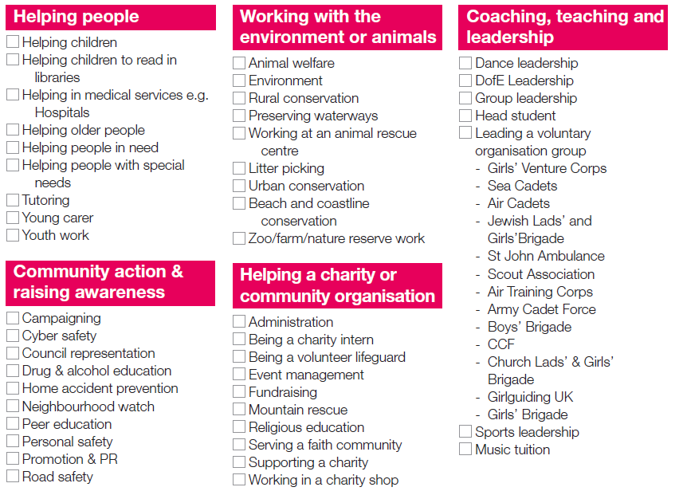
Volunteering - It’s about choosing to give time to something useful, without getting paid.

Slide 9
Volunteering under COVID restrictions
– You can be a social media volunteer for St John Ambulance
– You can fundraise to raise money for the Royal medical Benevolent Fund through Medic Mentor
– You can take part in a John Muir Award and help to conserve nature from home
– Volunteer for Kissing It Better and remote support elderly people who are in isolation
– Take part in a digital personal safety campaign with Resolve It
– St John Ambulance – 12 week fundraising plan
– Try some ideas from Leonard Cheshire’s guide to 12-week volunteering from home
– Putting the fun in fundraising with the British Heart Foundation
– Become an Energy Envoy with the National Energy Foundation
– Virtual volunteering
– Missing maps project
– Participate in research of all kinds, from classifying galaxies to counting penguins to transcribing manuscripts with Zooniverse
– If you are a Young Carer, your caring responsibilities can count for your volunteering. The Assessor should be a professional who is supporting you with your caring role, ideally from a Young Carers Project or Social Work/Youth Work departments. Young Carers should also be encouraged to contact their nearest Young Carers Project
– Prepare some sessions for future Beaver, Cub, Rainbow, Brownie or youth group meeting for once they resume
– Prepare some resources to be used by the younger members of your youth group to be sent home to parents online to help them during isolation
– Prepare some meal parcels, go shopping or walk the dog of people who are affected by coronavirus
– Skype talk / face time / WhatsApp call to the elderly neighbour to keep them from being isolated
– Maintain Facebook or Instagram page / websites for a local group or charity

Slide 10
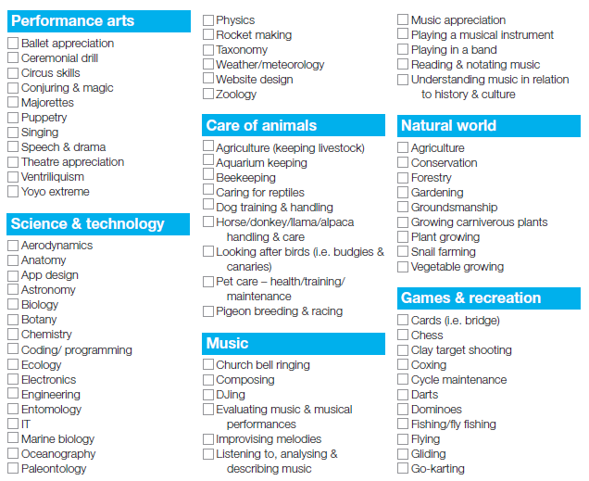
Skills You must be able to prove that you have broadened your understanding and increased your expertise in the skill

Slide 11
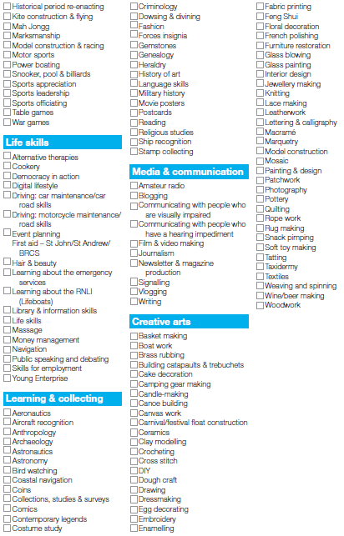
Skills You must be able to prove that you have broadened your understanding and increased your expertise in the skill

Slide 12
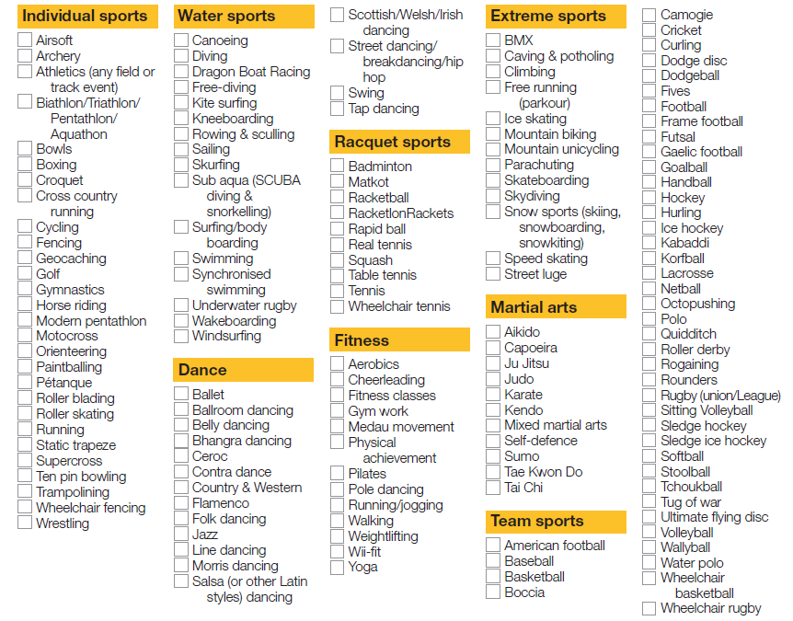
Physical A physical activity is anything that requires a sustained level of physical energy and involves doing an activity.

Slide 13
Evidence
Each section of the Award must be evidenced. Evidence can include:
Keeping Track booklet
Assessor’s Report Sheets (students can change activities so each change requires an assessor report sheet to be uploaded to the edofe site)
Activity logs with assessor and participant comments
Please Note: Each section must include one or more Assessor’s Report
Photographs and videos can be used to enhance evidence but cannot be used on their own as they only show a small snapshot of time.
Responsibility for Activities
It is your responsibility as a parent/carer to ensure that the activity your child undertakes is safe .
Assessors
These can be anyone associated with the activity who is in a position of responsibility e.g. A sports coach or a voluntary organisation leader. Assessors must not be family members.

Slide 14
Activ Adventures expedition dates (and more)
Can be found online on the school community > co-curricular enrichment> Duke of Edinburgh

Slide 15
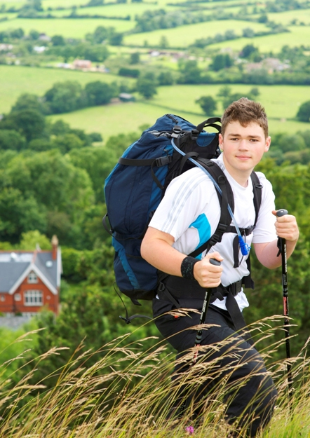
Expedition
Aim: To inspire young people to develop initiative and a sense of adventure and discovery, by planning, training for and completing an adventurous journey as part of a team.
Our chosen expedition provider is Activ Adventures. You are not obligated to use this provider.

Slide 16
Activ Adventures

Slide 17
Activ Adventures – Please see the separate Silver expedition presentation by Activadventures on the school website.

Slide 18
Expedition dates:
2020 October - Expedition Information sent out via school
2021
Saturday 30th January 2021 Training Day and route planning. In school. (9:15-17:00 for DIRECT* participants, 9:15 to 13:30 for all others)
Thursday 25th February Parents Briefing (Further information in preparation for expeditions. Not compulsory but all parents and participants invited) (18:00-19:00)
(The above may be an emailed presentation due to COVID restrictions on meetings)
Wednesday 12th May Kit drop and briefing for practice expedition (15:00-15:30)
28th-30th May Practice Expedition. 3-day expedition. New Forest.
Wednesday 14th July Route planning and Kit drop for qualifying (15:00-17:30)
Saturday 17th - Monday 19th July Qualifying Expedition. 3-day expedition. South Downs.
* DIRECT participants are those who have not taken part in a previous level of the award

Slide 19
How much will the award cost?
Silver: For students in Year 10 +. Enrolment fee of £32 + expedition cost £325 (please see the Activadventures presentation on the expedition).
By when does this payment need to be made?
The enrolment fee needs to be paid via ParentPay before Monday 2 November 2020. The fee for the expedition can be paid later in the autumn term, see Activadventures.
In addition we need an Enrolment Form, handed into the purple box in the second reception foyer.

Slide 20
The Activ expedition costs for 2020-2021 (Silver) are £325:
Extra expenditure: a good pair of walking boots, warm layers, waterproofs

Slide 21
How is the Award being run at WHSG?
Wallington High School for Girls will be co-ordinating the Award and will deal with enrolments, queries and approvals for the Award.
ActivAdventures will deliver the expedition section of the Award providing in school training sessions, a training day, practice expedition and qualifying expedition.
The award is student-led.
Students will be expected to attend the expedition Training Day, all expeditions and upload all information onto the edofe site.

Slide 22
What happens next?
Pay the enrolment fee of £32 for Silver via ParentPay by Monday 2 November 2020. . WE CANNOT ACCEPT STUDENTS ONTO THE AWARD SCHEME AFTER THIS DATE
2. Complete an enrolment form, downloadable from the website. Return to the Purple Box in the second Reception area by Monday 2 November 2020.
3. Enrol online with ActivAdventures for the expedition, following the instructions on the application letter.

Slide 23
Then what?
Once the enrolment forms have been received they will be sent off. Your child will receive her eDofE log-in and password by email to her school email account during the fortnight after the enrolment closes.
Welcome enrolment packs will be sent to the student’s home address. This will inform students how to collect evidence and what the criteria are for valid activities in each skill section.
Your child starts her award and uploads all of her activity information onto edofe, the online portal. Dr Walters from WHSG will then approve the nature of the activities or suggest alternatives if an inappropriate activity is chosen.

Slide 24
Any Questions?
Queries can also be emailed to dofe@wallingtongirls.org.uk

